Slide 1
Gap Analysis and Rate of Progress

Slide 2
The key to determining the amount of time an intervention should be in place and at what level of intensity in order to close the gap!

Slide 3
What is meant by the requirement in Rule 6A-6.0331(1)(e), F.A.C., that general education interventions “…be implemented as designed for a period of time sufficient to determine effectiveness?”
Instructional strategies and interventions must be delivered for a “sufficient period of time” (i.e., of sufficient duration to allow the team to gather adequate data to determine effectiveness). The determination of what is a sufficient period of time cannot be arbitrarily established and applied across situations, but must be decided individually based on a number of factors, including discrepancy in the student’s level of performance and rate of progress in comparison with peers, intensity of the intervention, duration of implementation in a standard intervention protocol, and rate of progress that can realistically be expected.
Interventions can vary in dosage and intensity across multiple dimensions, including length of intervention sessions (e.g., 5 minutes, 60 minutes), frequency (e.g., twice per day, once per week, every 30 minutes) and duration (e.g., three weeks, one grading period). In addition, some interventions are more intense in focus and delivery (e.g., specialized instruction in targeted skills delivered one-on-one or to a small group of students versus additional instructional time in the core curriculum delivered to a class of students).
Interventions matched to the individual needs of the student implemented with fidelity and appropriate intensity for a sufficient period of time are critical to an effective MTSS.
TAP: General Education Intervention Procedures, 11/20/15

Slide 4
Who is responsible for determining whether an intervention has an adequate level of intensity? How is this done?
The problem-solving team determines the level of intervention intensity required based on the student’s response data.
There is no established criterion or formula for identifying the appropriate level of intensity for an intervention. The team must review the relevant data and determine, on a case-by-case basis, the extent to which the intensity of an intervention is appropriate and effective.
The team is responsible for ensuring that the intervention is clearly defined and linked to the identified concern or skill deficit, that the individual implementing the intervention is appropriately trained and supported, and that the intervention is being delivered as designed. If the intervention is not being delivered as designed, more support should be provided to the staff involved. If the intervention does not result in sufficient improvement, the intervention should be revised, modified or intensified.
TAP: General Education Intervention Procedures, 11/20/15
Notes:
#2 – no established criterion or formula
We’re going to show you the method the state introduced in their initial PS/RtI trainings in 2008 which is what Citrus County adopted as our standard method.
We’re also going to show you how to determine if a goal is ambitious, but reasonable based on the “green book” – Annual Growth, Catch Up Growth.
FastBridge also has a built-in process for determining ambitious, but reasonable which we will explore a little later.
Sometimes the intervention programs you’re using will establish the required level of intensity for you.
Other times, it’s completely up to the team to make the best determination possible based on the available data.

Slide 5
Standard Method for Completing a Gap Analysis
Gap = Expected Level
Current/Observed Level
Rule of Thumb: 2.0 = significant gap
(The student would have to double their current rate of performance to catch up.)

Slide 6
Closing the Gap
How much time do we have to close the GAP?
Example:
90 minutes daily is needed for annual growth in reading.
If the student is one year behind, annual growth + catch up growth = 180 minutes.
If the student is two years behind, annual growth + catch up growth = 270 minutes.
Annual Growth For All Students, Catch-Up Growth for Some Students
Fielding, Kerr, and Rosier, 2008
Notes:
Understanding the idea of typical annual growth helps put the “gap” in perspective. It also helps us see why gap analysis and rate of progress is so important in determining the amount of time an intervention should be in place and at what level of intensity in order to close the gap!

Slide 7
Determining Rate of Progress
Measure the difference between desired & current performance.
Divide by the number of weeks intervention will be in place.
Set goals which are ambitious, but reasonable – rate required to reach goal is 25 – 50% above typical rate determined by gap analysis.
Notes:
Ambitious, but reasonable – we don’t want to set kids up for failure by creating learning goals that are impossible to achieve during the time we have an intervention in place. This allows us to set realistic goals and consider long-range planning, if necessary.

Slide 8
Tier 1: Monitoring Student Progress
Desired minus Current divided by Number of Weeks
Sight Words: 100 - 30 / 36 weeks
70 Sight Words/ 36 weeks
1.9 new sight words learned each week in order to close the gap
Now you’re ready to progress monitor!
Notes:
If the student’s growth doesn’t equal at least 2 words gained per week each time you progress monitor:
*Baseline = 30 Next data point collected if you monitor once a week should = 32…34…36…
*Baseline = 30 Next data point collected if you monitor every other week should = 34…38…42…
Use the data to help you adjust the instruction (frequency, duration, delivery method).
If the student isn’t meeting the expected growth trajectory, consider the potential need for a formal intervention plan (Tier 2 PMP).

Slide 9
Gap Analysis: Sight Words (example 1)
Target Student’s Observed/Current Level of Performance: Reads 30 Sight Words
Expected Level of Performance: Reads 100 Sight Words
Peer Level of Performance: Reads 92 Sight Words
Gap Analysis:
Expected Level/Target Student:
100/30 = 3.3 difference SIGNIFICANT GAP
Expected Level/Peer:
100/92 = 1.0 difference NO SIGNIFICANT GAP
Notes:
Why would you determine the peer level of performance?
Does this student require intervention? With a “3.3 gap”, would you begin with a Tier II intervention or consider more intensive support at Tier III to help close the gap?

Slide 10
Gap Analysis: Sight Words (example 2)
Target Student’s Observed/Current Level of Performance: Reads 70 Sight Words
Expected Level of Performance: Reads 100 Sight Words
Peer Level of Performance: Reads 92 Sight Words
Gap Analysis:
Expected Level/Target Student:
100/70 = 1.4 difference NO SIGNIFICANT GAP
Expected Level/Peer:
100/92 = 1.0 difference NO SIGNIFICANT GAP
Notes:
Does this student require intervention? Probably not a Tier II intervention formally documented on a PMP. Perhaps some differentiated small group instruction?

Slide 11
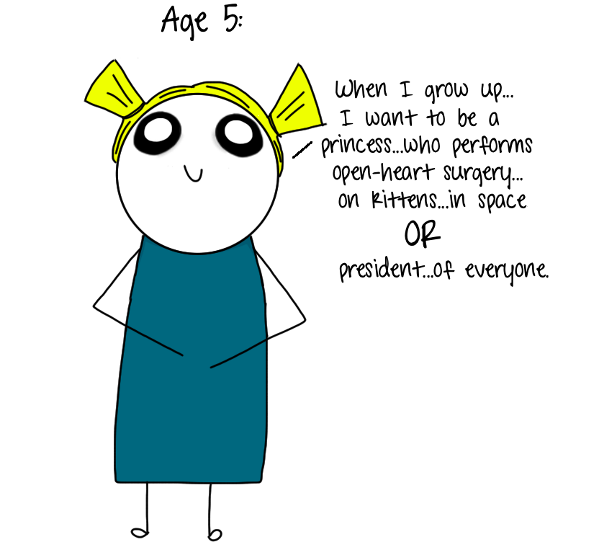
Ambitious, but reasonable…

Slide 12
Gap Analysis: Fountas & Pinnell Fluency (Grade 4)
Target Student’s Observed/Current Level of Performance: 1st assessment window – 58 wpm
Expected Level of Performance: 1st assessment window – 120 wpm
Peer Level of Performance: 1st assessment window – 118 wpm
Gap Analysis:
Expected Level/Target Student:
120/58 = 2.2 difference SIGNIFICANT GAP
Expected Level/ Peer:
120/118 = 1.4 difference NO SIGNIFICANT GAP

Slide 13
Rate of Progress: Fountas & Pinnell Fluency (Grade 4)
Desired minus Current divided by Number of Weeks
Fluency Rate (based on the 3rd assessment period): 160 - 58 / 36 weeks
102 wpm / 36 weeks
2.8 wpm per week (1.1 per week is typical for the grade level)
Is this ambitious, but reasonable?
Notes:
Typical Rate:
160 – 120 = 40 word increase expected for the average 4th grade student over the course of the year.
40 / 3 = 13.3 wpm gain expected each assessment period for the average 4th grade student over the course of the year.
36 / 3 = 12 weeks in each assessment period.
13.3 / 12 = 1.1 wpm gain expected each week for the average 4th grade student over the course of the year.
**Mention FastBridge progress monitoring does this type of calculation for you if you’re using that tool.

Slide 14
Ambitious, but Reasonable: 25 – 50% Growth Rate Above & Beyond “Typical”
For the lower end of the range – multiply the typical rate by 1.25
Typical rate is 1.1 wpm per week
25% growth would be 1.1 x 1.25 = 1.4
For the upper end of the range – multiply the typical rate by 1.50
Typical rate is 1.1 wpm per week
50% growth would be 1.1 x 1.50 = 1.65
Is a growth rate of 2.8 wpm per week an ambitious, but reasonable goal for our student?
Notes:
NO (anything beyond 1.65 would NOT be a reasonable rate of progress for this student)
Use the data to help you adjust the instruction (frequency, duration, delivery method).
Discuss with your TOSA the potential need to schedule more intensive interventions.
THIS CALCULATION MAY NOT BE POSSIBLE WITH EVERY SCORE YOU ANALYZE! Only if you can first determine a typical rate of growth over the course of a year.

Slide 15
Example: Explicit Comprehension ?s (Gap)
Target Student’s Observed/Current Level of Performance: 38%
Expected Level of Performance: 80%
Peer Level of Performance: 82%
Gap Analysis:
Expected Level/Target Student:
80/38= 2.1 difference SIGNIFICANT GAP
Expected Level/Peer:
80/82 = <1x difference NO SIGNIFICANT GAP

Slide 16
Explicit Comprehension ?s (Rate)
Desired minus Current divided by Number of Weeks
Explicit Comprehension ?s: 80 - 38 / 36 weeks
42 / 36 weeks
1.2 percentage points gained each week
But what is typical for the grade level?
Is this ambitious, but reasonable?
Our “1.25/1.50” calculation doesn’t help us in this scenario because we do not have any clear cut scores to determine the typical rate of progress for this skill.

Slide 17
FastBridge: Ambitious, but Reasonable Goals
Knowledge Base: “Setting Up Progress Monitoring Groups”
Screening to Intervention Report
Requires administration of aReading & CBMReading for maximum benefit
Creates student profile and assigns students to categories of need
Suggests goals for accuracy, automaticity, or both
Suggests optimal instruction techniques for growth
Notes:
Both of these FastBridge tools provide guidance for setting ambitious, but reasonable goals. (Login to provide live demo of how to determine realistic vs. ambitious goals based on student data.)
In the Knowledge Base, there is guidance for setting up progress monitoring groups:
-”Setting Up Progress Monitoring Groups” (Video: 9:47)
-”Setting UP Progress Monitoring Groups” step-by-step directions with screen shots
The Knowledge Base also has guidance for using the “Screening to Intervention Report”:
-”Screening to Intervention Report” Video (4:14)
-This makes it easier for teachers to understand which tools to use for specific students

Slide 18
Example: Math Problem Solving
Student’s Performance = 62%
Expected Performance = 80%
Peer Performance = 78%
Gap Analysis:
Expected ÷ Student ( 80/62 = 1.29). This is not a significant gap.
Peer ÷ Student (78/62 = 1.25). This is not a significant gap.
Rate:
(Desired – Current) ÷ Number of Weeks
(80 -62) ÷ 27 = .67 percent needed per week
Notes:
This example provides a gap analysis of the student compared to the peer’s current level of performance. It’s ok to take this into consideration if the peer group is meeting the proficiency expectation. You would not want to make this kind of comparison if you have “dirty water”.

Slide 19
Example: Math Multiplication Facts
Expectation: 100 facts
Actual Performance: 9 facts
Peer Performance: 50 facts
Gap Analysis:
Expectation/Actual (100 ÷ 9) = 11.1 This is a significant gap.
Peer/Actual (50 ÷ 9) = 5.5 This is a significant gap.
Rate of Progress:
(Desired – Actual) ÷ Number of Weeks
(100-9)/30
91/30 = 3
The student would need to learn 3 new facts per week to meet the expectation in 30 weeks.
Notes:
This is another example providing a gap analysis of the student compared to the peer’s current level of performance. Our target student is in need of intervention, but so is the rest of the class! This is an example of when core needs to be re-examined for the whole group. Our peer group has a gap of 2.0 and needs to learn 2 new facts per week themselves in order to meet the expectation in 30 weeks. This is probably not a “student specific” problem that needs to be addressed with a PMP through tiered interventions (at least not initially).

Slide 20
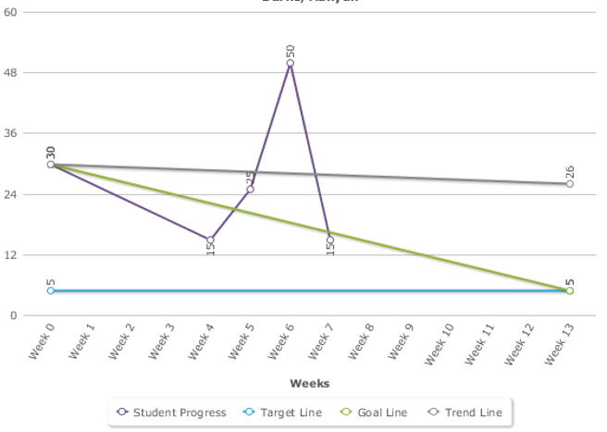
Example: Extinguishing an Undesirable Behavior
Looking for a decrease in behavior.

Slide 21
Gap & Rate: Disruptive Episodes
Average time spent in disruptive episodes: 27 minutes
Goal: 5 minutes
Gap Analysis: Current Average - Goal
27-5 = 22
Rate of Progress:
Minutes needed to be reduced ÷ Number of Weeks
22/10 = 2.2
Student needs to show a reduction of 2.2 minutes per week to reach the goal in 10 weeks.
Notes:
PST team needs to decide on how fast the behavior needs to be reduced and how reasonable it is to expect a given reduction in behavior.

Slide 22
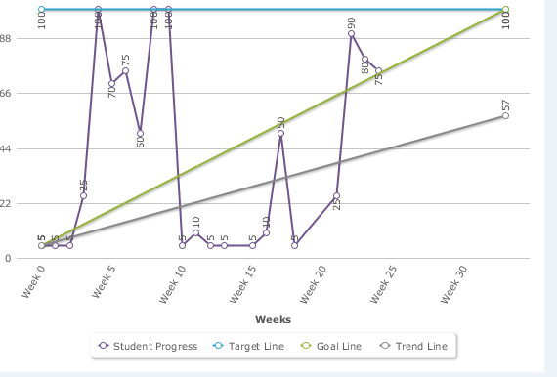
Example: Increasing a Desirable/Replacement Behavior
Example looking for an increase in behavior.

Slide 23
Gap & Rate: Increasing a Desirable/Replacement Behavior
Initial Score: 5 Average Score: 39 Most recent score: 75
Goal: 100
Gap Analysis:
Goal/Expected – Most Recent Score
100-75 = 25
Rate of Progress:
Points Needed ÷ Number of Weeks
25/8 = 3.125
3-4 points needed per week to meet goal in 8 weeks.

Slide 24
Example:
Class Dojo Data
Initial Score = 40 %
Student’s Average Score = 61%
Most Recent Score = 43%
Class Average = 90%, Target = 80%
Gap Analysis:
Goal/Expected – Most Recent Score
80%-43% = 37%
Rate of Progress:
Points Needed ÷ Number of Weeks
37%/16 weeks = 2.3 %
2.3% needed per week to meet goal in 16 weeks

Slide 25
Utilizing FastBridge Scores

Slide 26
Utilizing FastBridge Scores
Benchmark Score (Current Expectation): 213
Student’s Performance: 205
Peer Performance: 214
Gap Analysis:
Expectation – Actual Student Performance (213-205) = 8
Peer Performance – Student Performance (214-205) = 9
Rate of Progress:
Available as ROI on Fastbridge growth reports.
For this student: 0.75

Slide 27
Utilizing FastBridge Scores
Is the student on target to meet the Spring benchmark?
Spring Benchmark = 218
Student’s current score = 205
Student’s ROI = .75
4 months between December and April assessments.
4 months X .75 = 3.0
Current score + Projected Growth = Projected final score
205 + 3 = 208
Student is not projected to meet Spring benchmark.
Notes:
Fastbridge is looking at the long-term. Are we on target to meet expectations? Is it reasonable to meet the expectation in the time left. How intensive does intervention need to be?

Slide 28
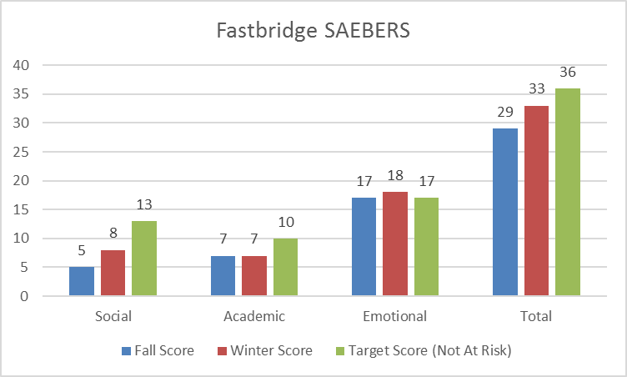
Utilizing FastBridge Scores
Fastbridge SAEBERS Gap Analysis/Rate of Progress (Longer Term Progress Monitoring)

Slide 29
Utilizing FastBridge Scores
Expectation: 36 (Not at Risk)
Actual Performance: 33 (At-Risk)
Gap Analysis: Expectation ÷ Actual performance
36/33 = 1.09. This is not a significant gap.
Rate of Progress:
Winter Score – Fall Score
33-29 = 4 (Current progress used to make prediction for next assessment period)
Is the student likely to meet the expectation?
Current Score + Predicted rate of progress
33 + 4 = 37
Student is predicted to meet the expectation.
Notes:
Same procedure could be used for subscales.
Remember Fastbridge is looking at the long-term. Are we on target to meet expectations? Is it reasonable to meet the expectation in the time left. How intensive does intervention need to be?

Slide 30
Types of Scores
When a new test is developed, it is normed on a sample of hundreds or thousands of people. The sample should be like that for a good opinion poll: female and male, urban and rural, different parts of the country, different income levels, etc. The scores from that norming sample are used as a yardstick for measuring the performance of people who then take the test. This human yardstick allows for the difficulty levels of different tests. The student is being compared to other students on both difficult and easy tasks. You can see from the illustration below that there are more scores in the middle than at the very high and low ends. Many different scoring systems are used, just as you can measure the same distance as 1 yard, 3, feet, 36 inches, 91.4 centimeters, 0.91 meter, or 1/1760 mile.
Myschoolpsychology.com

Slide 31
Types of Scores
PERCENTILE RANKS (PR) simply state the percent of persons in the norming sample who scored the same as or lower than the student. A percentile rank of 50 would be Average – as high as or higher than 50% and lower than the other 50% of the norming sample. The middle half of scores falls between percentile ranks of 25 and 75.
STANDARD SCORES ("quotients" on some tests) have an average (mean) of 100 and a standard deviation of 15. A standard score of 100 would also be at the 50th percentile rank. The middle half of these standard scores falls between 90 and 110.

Slide 32
Types of Scores
SCALED SCORES ("standard scores” on some tests) are standard scores with an average (mean) of 10 and a standard deviation of 3. A scaled score of 10 would also be at the 50th percentile rank. The middle half of these standard scores falls between 8 and 12.
T SCORES have an average (mean) of 50 and a standard deviation of 10. A T score of 50 would be at the 50th percentile rank. The middle half of T scores falls between approximately 43 and 57.

Slide 33
Types of Scores

Slide 34
Follow-Up With:
Stephanie Gardner
Sarah Hebert
Katie Manning
Jessica Reynolds

